Slide 1
Detection of Alzheimer's using MRI Images
Abhinav Reddy Mandadi

Slide 2
INTRODUCTION
Alzheimer's disease is a brain ailment that gradually impairs thinking and memory abilities as well as the capacity to do even the most basic tasks.
The methods for diagnosing Alzheimer's are exceedingly expensive and most of them are not FDA-approved.
The OASIS (Open Access Series of Imaging Studies) website is the primary source of the datasets.
The project's objectives are to develop an algorithm that can detect Alzheimer's without a doctor's help. In doing so, the cost will go down and the disease will be more easily diagnosed.

Slide 3
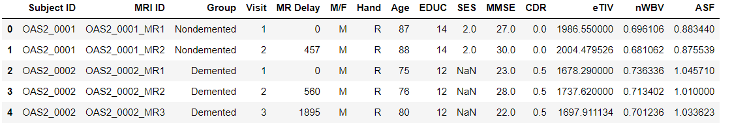
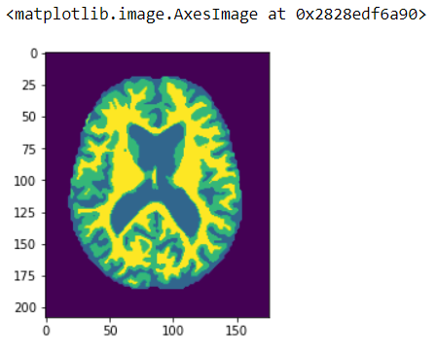
ABOUT THE DATA
For the project, we are using 2 datasets.
The first dataset consists of the medical information of the patients.
This is used as a benchmark to check the classification capabilities of the implemented regular classification algorithms.
The second dataset consists of medical information along with the MRI images of the patients.

Slide 4
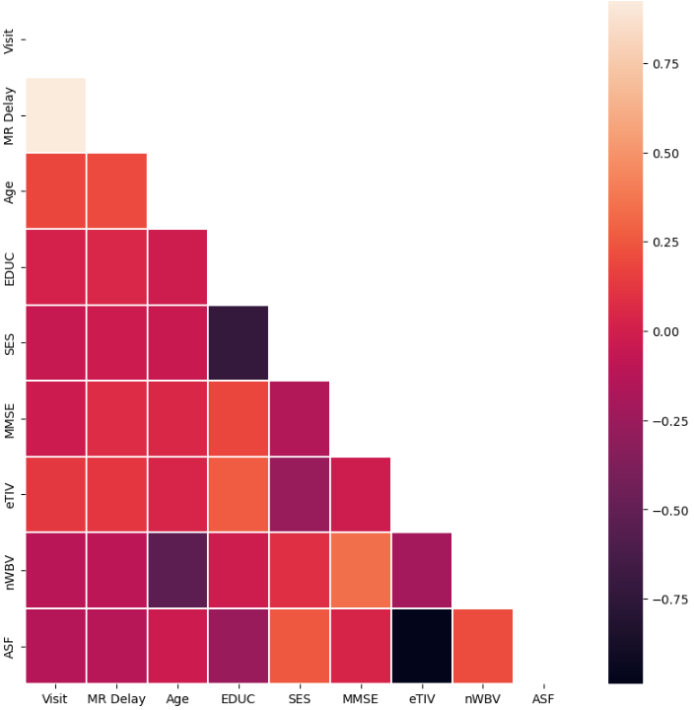
ABOUT THE DATA
The first dataset included data from 416 subjects and 434 MRI sessions with the below features.
Gender: M(Male)/F(Female).
Age: Age of the patient.
MR Delay
Subject ID: ID of the patient.
MRI ID: ID of the MRI.
Visit: Number of visits.
SES (Socio-Economic Status): It ranges from 1 to 5.
nWBV: Normalized Whole Brain Volume.
Educ: This feature corresponds to the levels of education ranging from 1 to 5.
MMSE: Mini-Mental State Examination.
CDR (Clinical Dementia Rating): Typically, a CDR value above 0 can be diagnosed with Alzheimer's.
eTIV: Estimated total intracranial volume (mm3).
ASF: Atlas scaling factor.
The correlations between the features of this dataset is as shown..

Slide 5
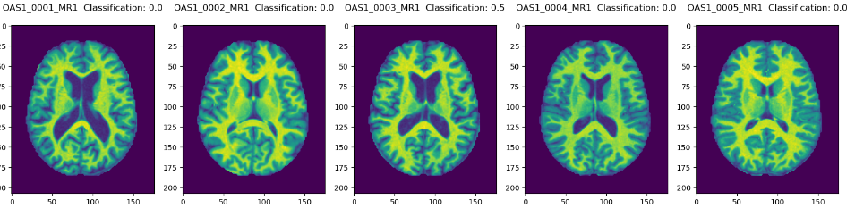
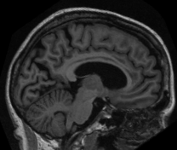
ABOUT THE DATA
The second dataset consists of MRI images as shown below.
There are also images taken from different angles.

Slide 6
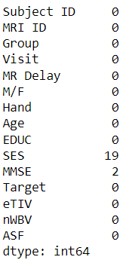
WORKING ON THE DATA
Firstly, the datasets are cleaned since the data is raw and needs to be cleaned.
Next, the datasets are normalised and encoded.
Finally the datasets are implementation ready.

Slide 7

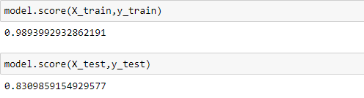
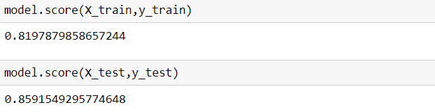
WORKING ON THE DATA
I implemented the Random Forrest and Logistic regression algorithm on the first dataset with varying hyperparameters.
The best estimators I got are shown below.
The highest accuracy for the Random Forrest algorithm is 83% while it is 85% for Logistic Regression.

Slide 8
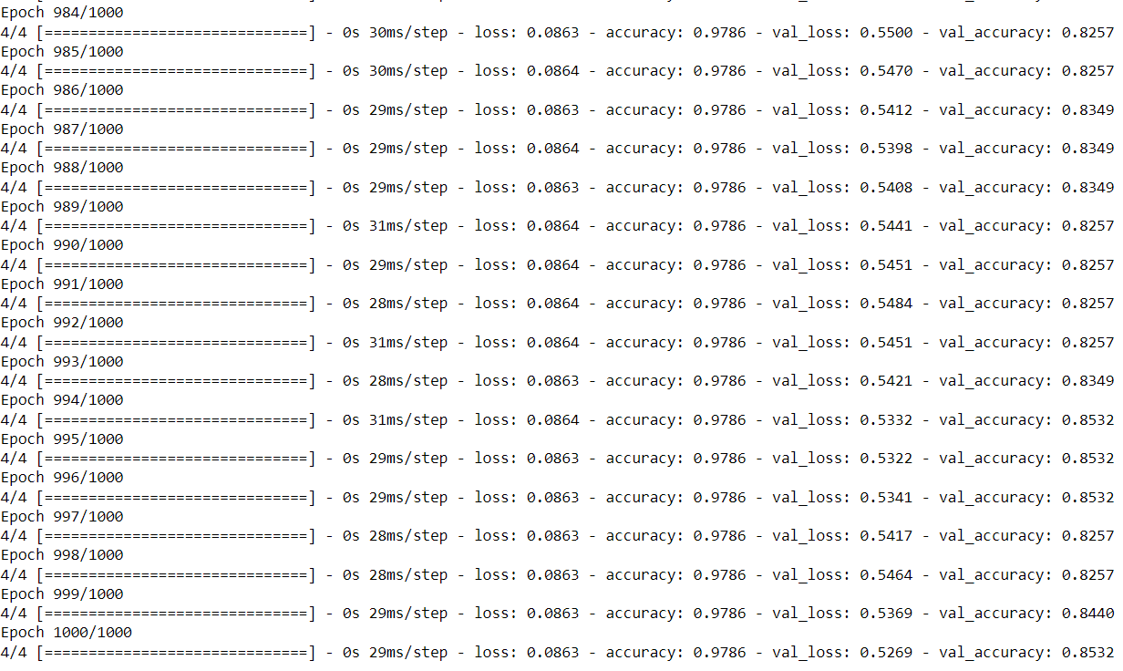
WORKING ON THE DATA
For the second dataset, I created a neural network to take in the MRI images and predict the disease.
The accuracy of this algorithm is 76%.

Slide 9
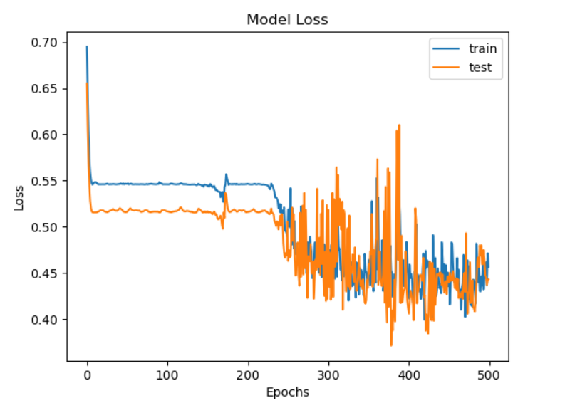
MODEL LOSS

Slide 10
CONCLUSION
Although the accuracy of the algorithm is around 79%, it can definitely be improved by testing a bit more on the dataset.
According to my calculations we can improve the accuracy to around 80%.
This makes is closer to the accuracy of the first dataset.

